Slide 1
Saving your PPT
Download the PPT template (“Final Robotics Projects Template 2017.pptx”) from Canvas and change the name to include:
Short DESCRIPTIVE Title
Your Name
Current Year
Delete This Page
A BAD name
“My Robot Project by Chris.pptx”
A GOOD name
“Robot Test Grader - Chris Odom 2017.pptx”

Slide 2
Code Notes
When you think your project is complete, check the following:
Your code works and the robot runs properly
Your code is well-commented with constants and variables that are named appropriately
Your code is tidy and neat with proper indentation. (Tidy it up with CTRL+T.)
Delete This Page

Slide 3
More Code Notes
Your header for ALL code files MUST include:
Your header SHOULD also include the following copyright information:
// FileName.ino by YourName on ThisDate
// DescriptionOfProject
/*
Copyright YourName CurrentYear. All Rights Reserved. No part of these contents may be reproduced, copied, modified or adapted, without the prior written consent of the author, unless when used for educational and non-profit purposes.
*/
Delete This Page

Slide 4
Title of your project here
Put one or two images here.
You may wish to change the background of this and all other pages.
Names of the team members here.
Year here.

Slide 5
Title of your project here
Write a short description of your project here. You may resize the box and the font, but don’t write too much. Make the project sound exciting. Really sell it. This will be published without any editing from me, so proof it well!
This page will be graded on:
Clarity
Completeness
Excitement generated

Slide 6
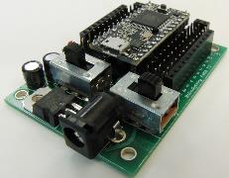
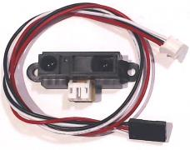
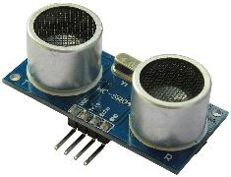
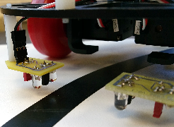
Materials List
Teensy 3.2 Microcontroller ($19.80) and Patton Robotics Motherboard ($18). https://www.pjrc.com/teensy/teensy31.html and http://pattonrobotics.com/products/patton-robotics-teensy-motherboard-kit.
Sharp Infrared Range Finder (P/N 2YOA21) ($9) from http://pattonrobotics.com/products/sharp-gp2y0a21-ir-infrared-range-sensor-cable. (See image above.)
Sonic Range Finder (P/N HC-SR04) ($3.75) from http://pattonrobotics.com/products/ultrasonic-sensor-and-cables. (See image above.)
Infrared Line-Following Sensors ($2) from http://pattonrobotics.com/products/line-sensors-by-patton-robotics. (See image above.)
Item. Link. Cost. Image.
If item is common like IR range finder, line follower, sonic ranger, e.g., then just listing the item is all you need.
If the item is unique to your project or is hard to find in general, then give a part number, a link to the item, and perhaps a cost of the item.
Images are great. It is fine to add additional slides here.

Slide 7
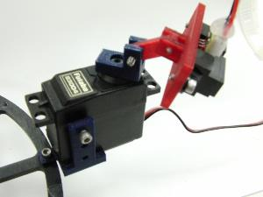
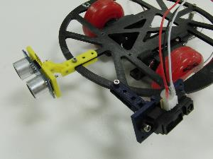
3D-Printed Parts
Here are the zipped file(s) containing all 3D-printed parts created by me. The file(s) include the SketchUp (*.SKP) and stereolithography files (*.STL) used in their production:
Futaba Servo Mount (by Hoang & Odom)
Sonic and Sharp IR Range Finder
If you used a 3D printed part, give an image (or images) of the piece.
Also, embed a ZIP file of at least the SketchUp (SKP) and STL files of your piece(s). Here’s how on a Window’s machine:
Select any files you want to add to the ZIP archive.
Right-click on those files and select “Send to >> Compressed (zipped) folder”.
Drag the zipped folder onto this PowerPoint slide.
If this doesn’t work, use http://www.ezyzip.com/

Slide 8
Images of My Project
Put images here.
OK to add more pages.

Slide 9
My Project on YouTube (Optional)
Here are some YouTube videos of my project:
For example: The 2012-13 George School Robotics Playlist
For example: Jake’s auto-tracking BB shooter
Here’s how to insert a link to your video in PowerPoint: Select the text with which you want to link to your file
On the Ribbon Bar, select Insert
Click on the Hyperlink button within the Links group
Make sure the Existing File or WebPage button is engaged and enter the web address.
Press OK and test the link(s) by running the presentation! YouTube should open!
Delete me and these instructions

Slide 10
My Code!
Below are links to all the Arduino C code files used in my project:
Hello_World.ino
Or you can store the code files in a ZIP file as shown on a previous slide.
Here’s how: First, make sure your code is exactly as you want it. Then copy the code from EACH of your program files and paste it in a text editor such as Notepad (Windows) or TextEdit (Apple). Save text file.
In the window that opens, select Create from file and Browse to find your text file. Add an Icon if you wish. Press OK and the object should appear on the page.
Click on the object. Then select Action from the Links Group within the Insert toolbar.
In the window that opens, select Object Action: Activate Contents. Press OK. Run the PPT and click on the Object to show the code text!
Next, on the Ribbon Bar,’s Text Group, select Insert then select Object.
Delete me and these instructions

Slide 11
Improvements, Applications, Suggestions & Advice
What real-world applications are there for your project?
Are there any future additions or alterations that would make your project even better?
Did you encounter any problems that couldn’t be solved? How did you work around them?
What would you have done differently?
You may add more pages

Slide 12
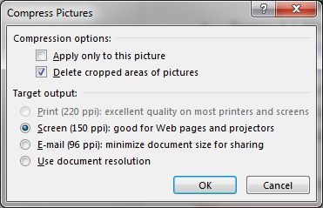
FINAL NOTES
Before turning in this PowerPoint, you should compress all the images in the document to make the document smaller. Here’s how:
Click on any image in the PPT.
Click on the Format menu under Picture Tools.
Click on “Compress Pictures”.
In the window that opens, uncheck “Apply only to this picture” and select “Screen (150ppi) as shown:
Delete This Page

